Slide 1
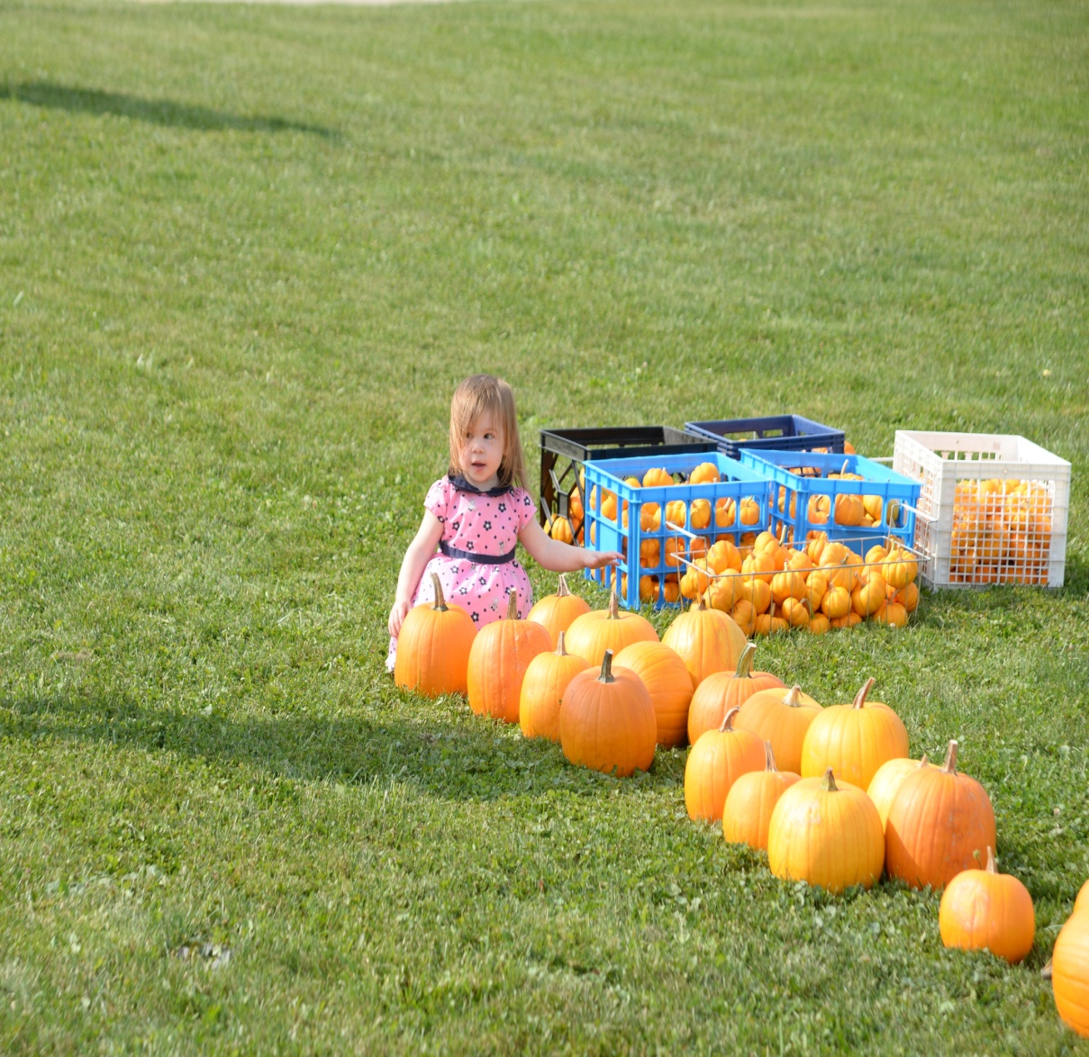
2014 - MCS Fall Festival
Fall Festival
Drive 4 Ur Community
Pinewood Derby
Car Show
Carnival

Slide 2
Saturday, September 20th 5AM

Slide 3
Drive 4 Ur Community

Slide 4
Drive 4 Ur Community

Slide 5
Drive 4 UR Community

Slide 6
Drive 4 UR Community

Slide 7
Graham Ford of Mansfield’s Crew

Slide 8
Pinewood Derby

Slide 9
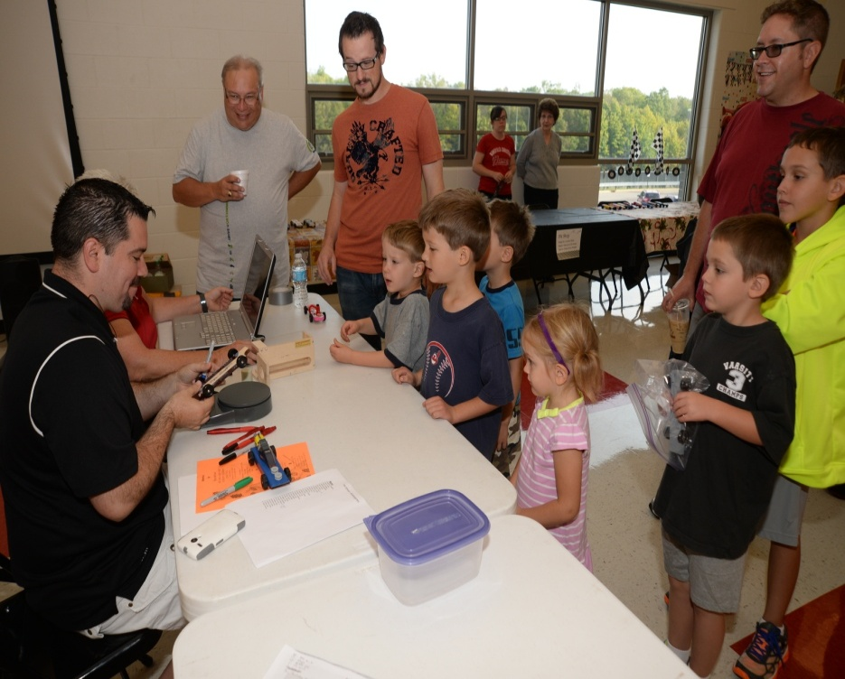
Pinewood Derby Weigh In

Slide 10
Pinewood Derby Volunteers

Slide 11
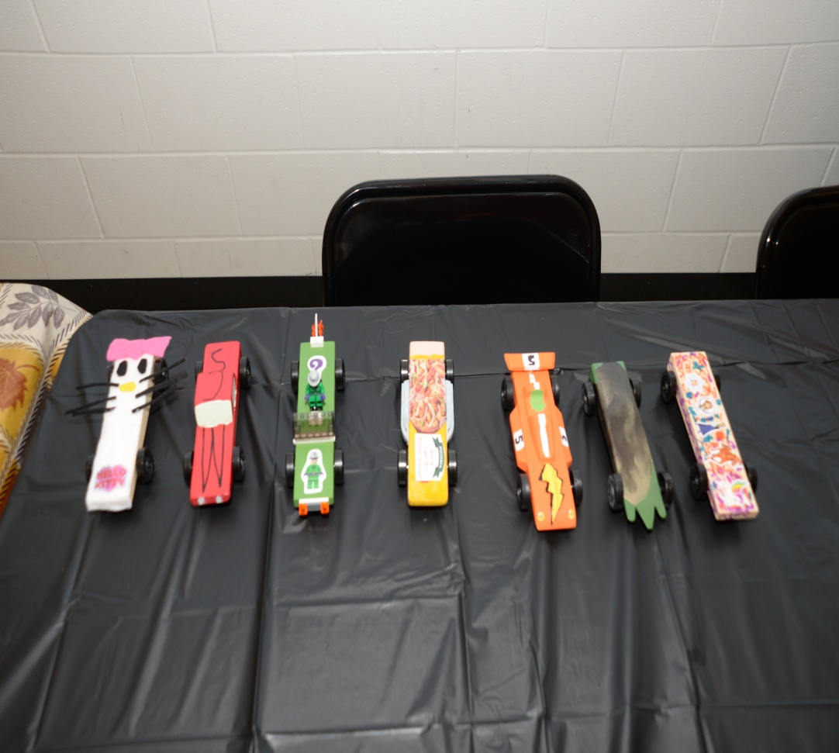
Pinewood Derby
Tow-mater & Lightning McQueen

Slide 12
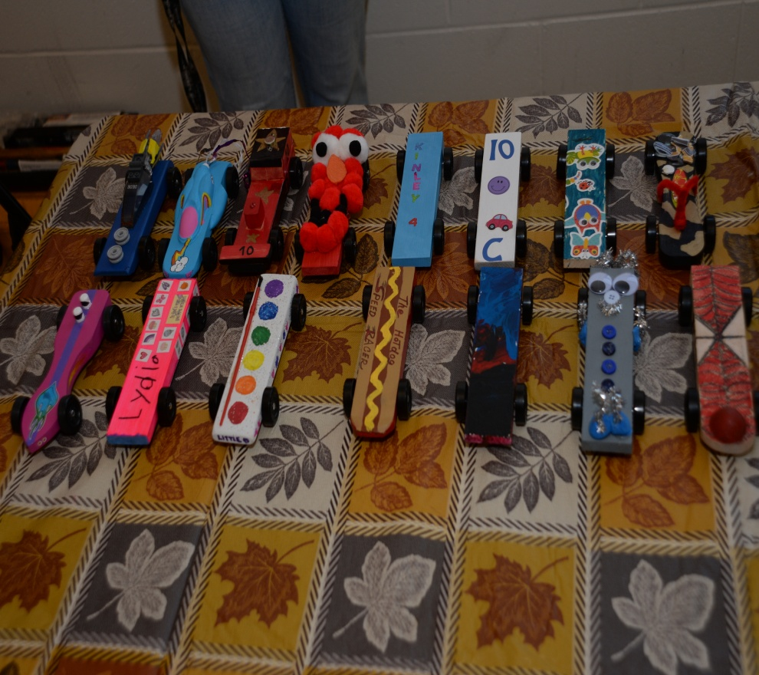
Pinewood Derby Competition

Slide 13
Pinewood Derby racers

Slide 14
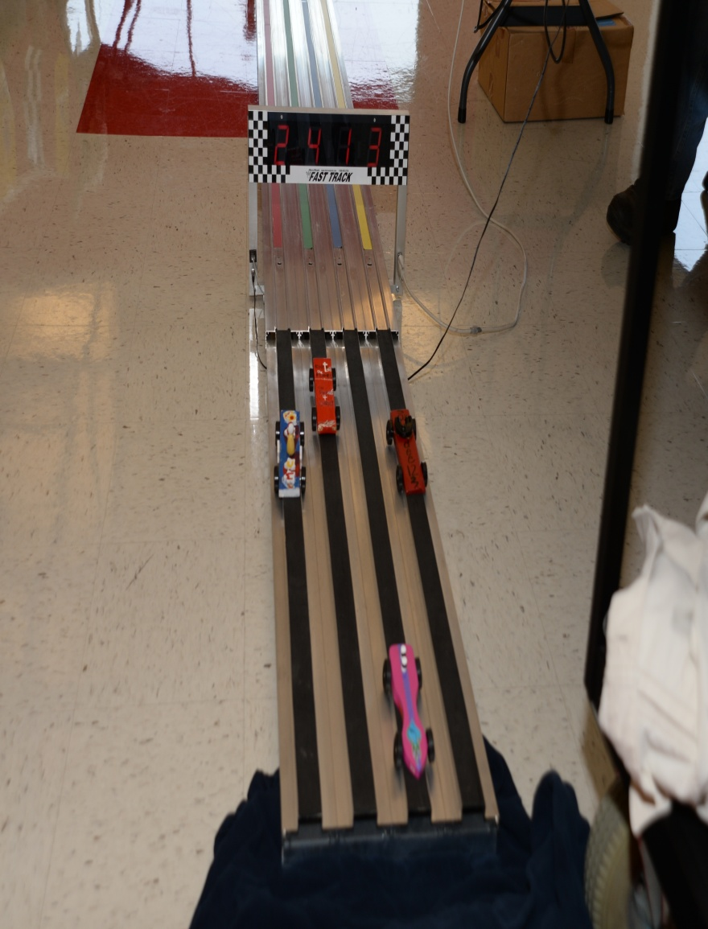
Pinewood Derby Race

Slide 15
Get Ready Get Set Get Go

Slide 16
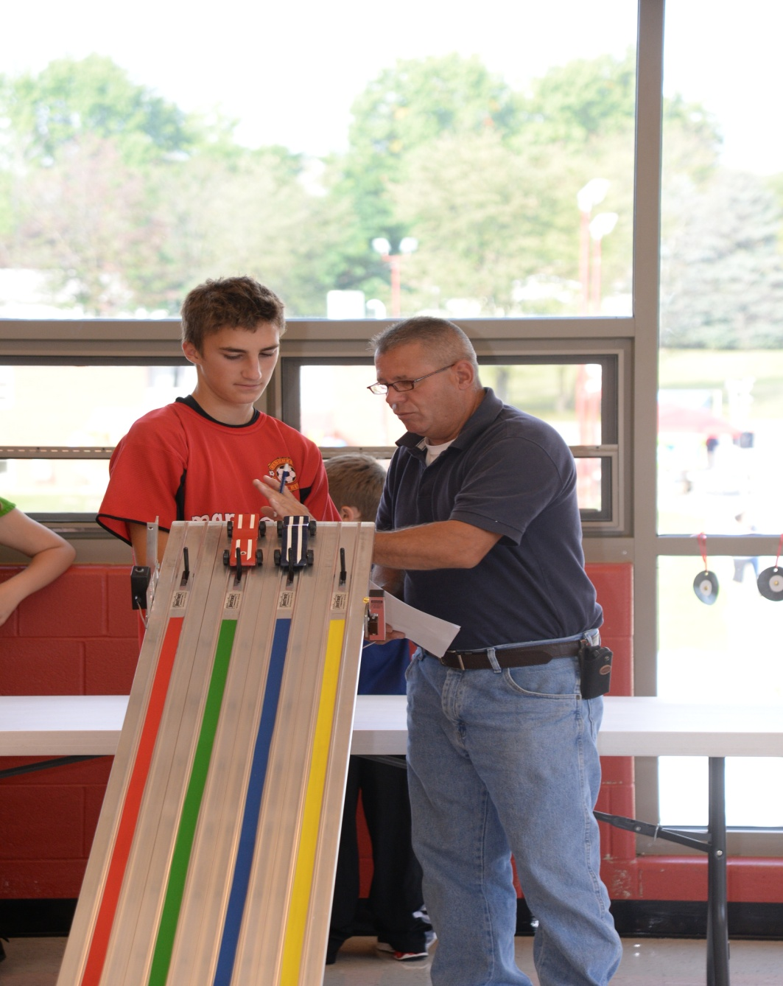
Pinewood Race

Slide 17
Pinewood Derby Fans

Slide 18
Race Fans

Slide 19
Pinewood Derby Fans

Slide 20
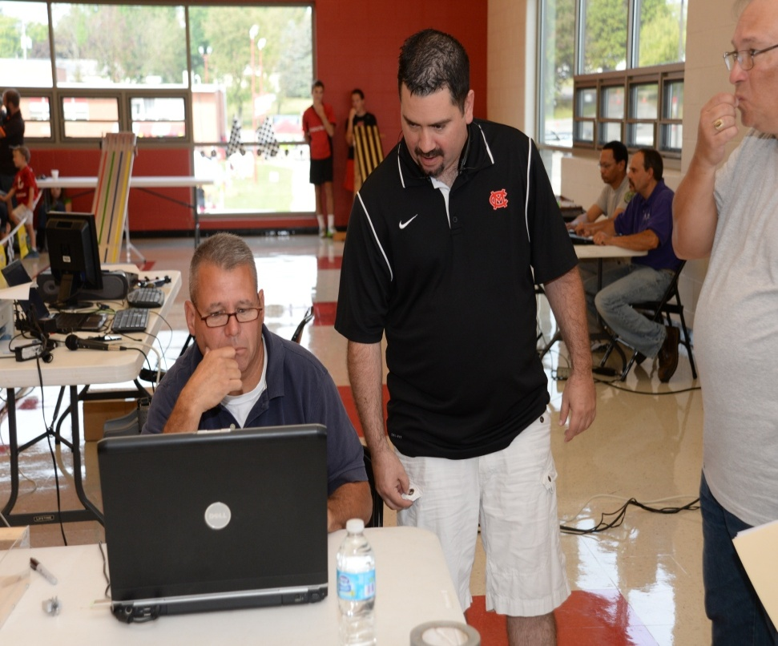
Pinewood Derby Tech’s

Slide 21
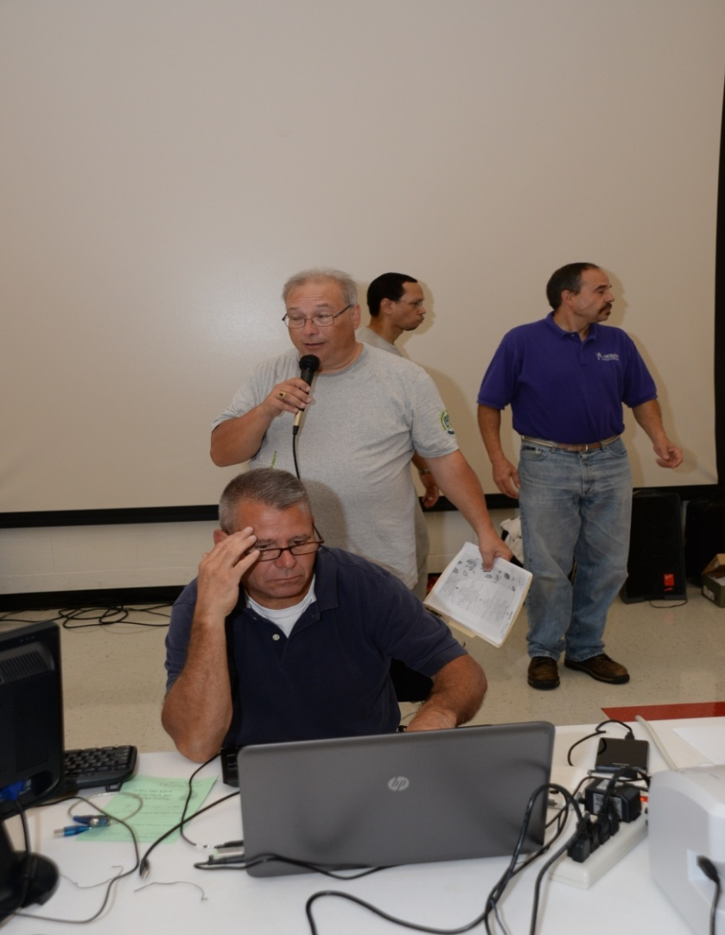
Derby Announcer – Scott Saunders

Slide 22
Pinewood Derby Awards

Slide 23
Awards

Slide 24
Trophies

Slide 25
Trophies

Slide 26
Awards

Slide 27
Festival Volunteers

Slide 28
Festival bag filling day
200 Car Show bags
200 Drive one bags
200 pinewood derby bags
That’s a lot of bags!

Slide 29
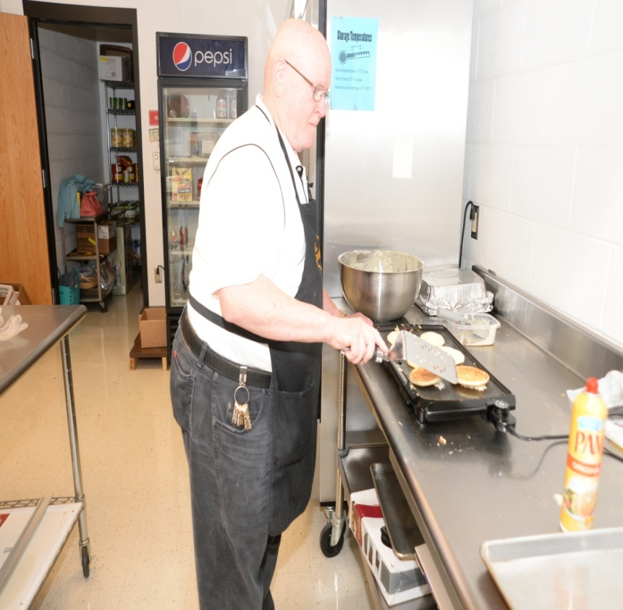
Pancake Breakfast

Slide 30
Pancake Breakfast

Slide 32
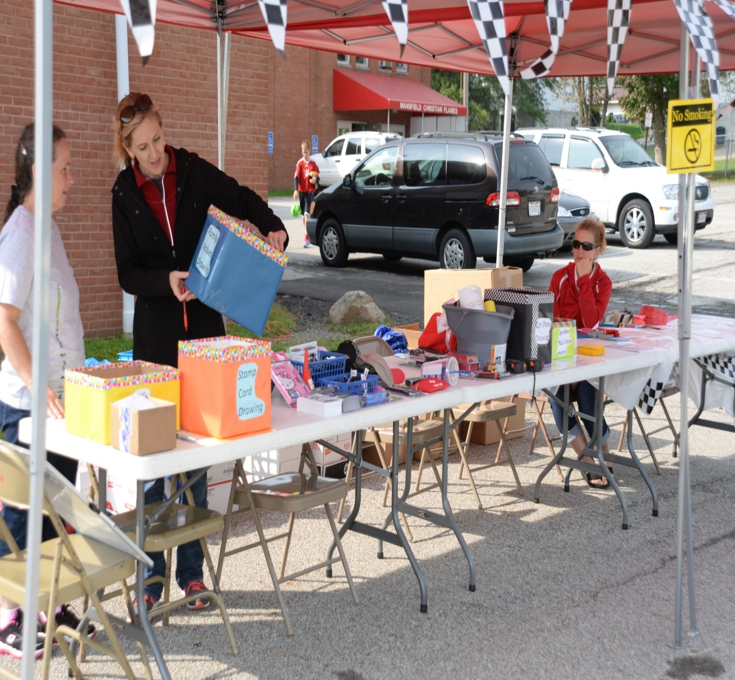
Car Show

Slide 33
Twins from Bellville brought their pink jeep

Slide 34
MCS Alumni

Slide 35
Mayberry Car

Slide 36
Mayberry Car

Slide 37
Student with Barney

Slide 38
Soap Box Derby Display by Brian Smith

Slide 39
The kids had fun looking at the Fire Truck!

Slide 40
Corn Hole between students and Car show participants.

Slide 41
Starting the Ice Cream

Slide 42
Ice Cream & Apple Dumplings
239 dumplings sold
A big hit!

Slide 43
Food Tent

Slide 44
Lunch time

Slide 45
Taking Orders for Lunch

Slide 46
Carnival Tickets

Slide 47
Games & Fun

Slide 48
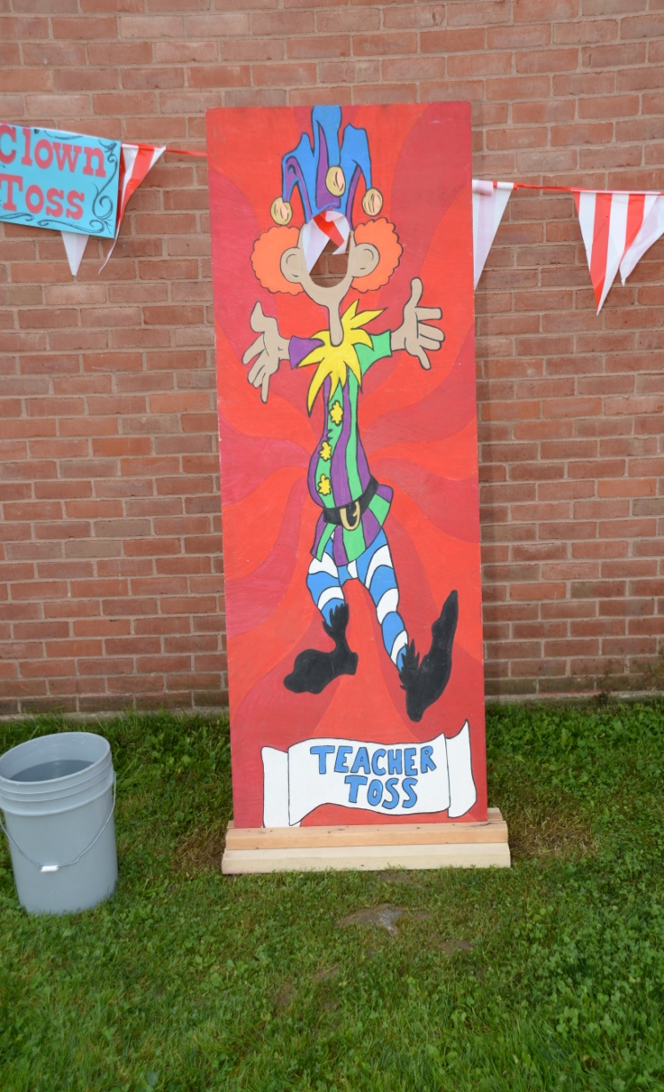
Lots of Games

Slide 49
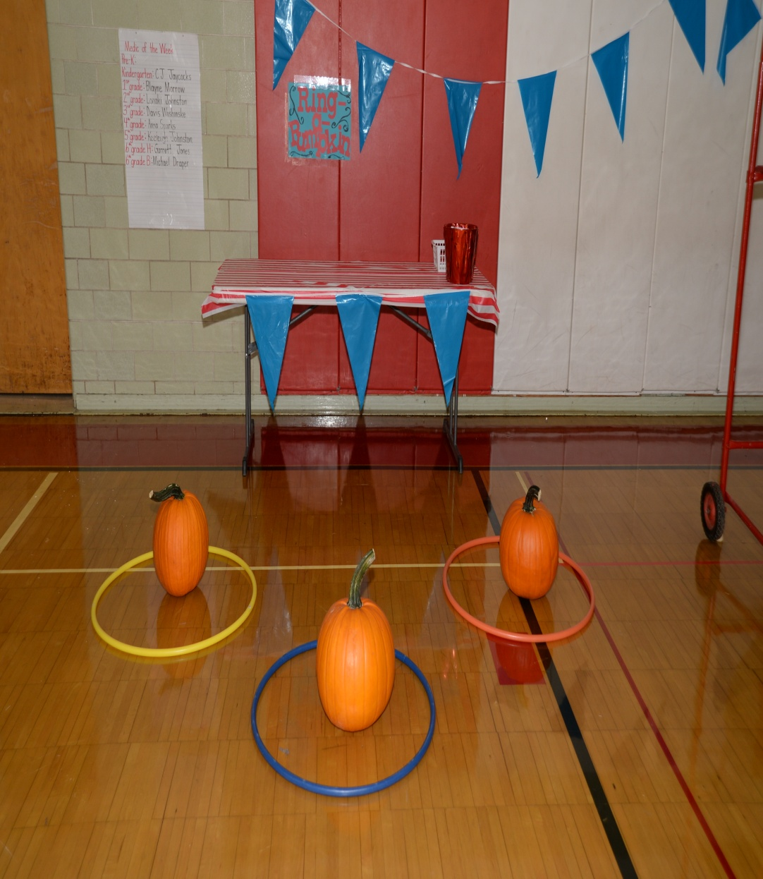
Lots of Fun

Slide 50
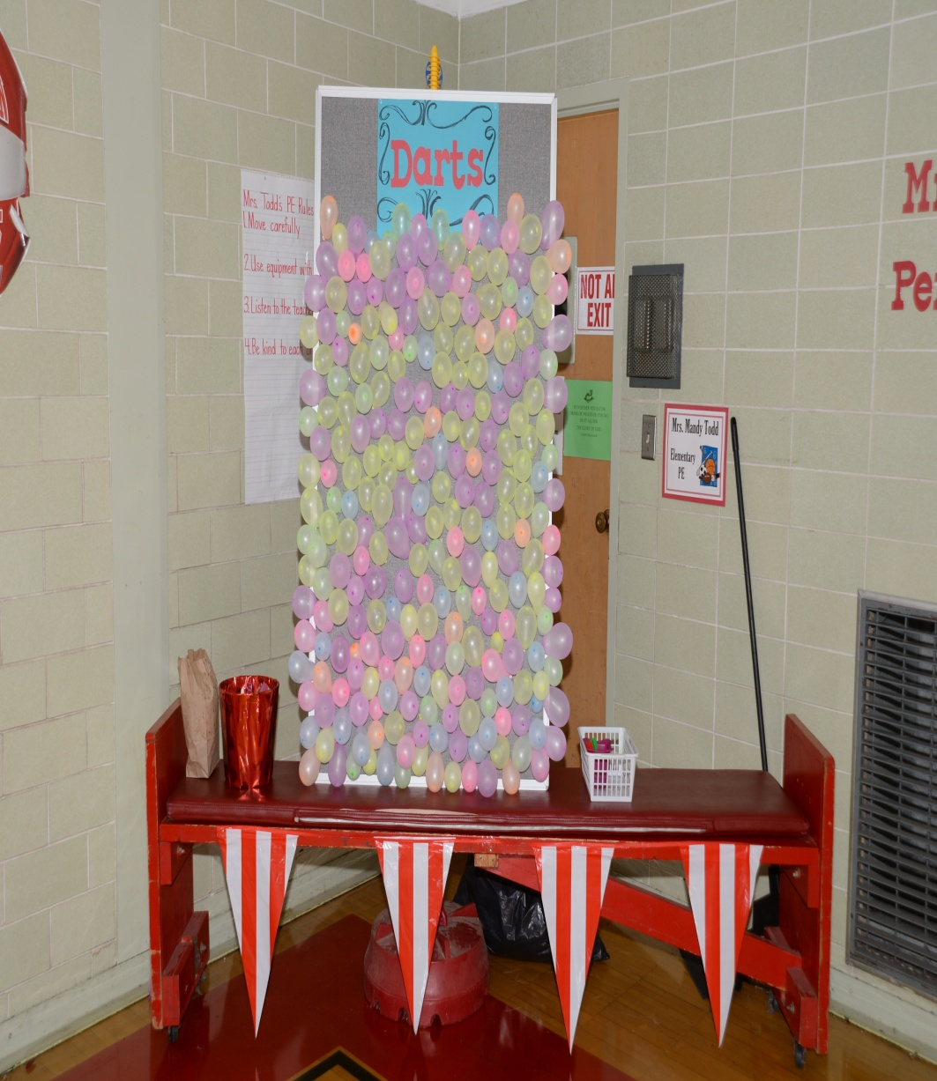
More Games

Slide 51
Kids loved the Teacher Toss Game

Slide 53
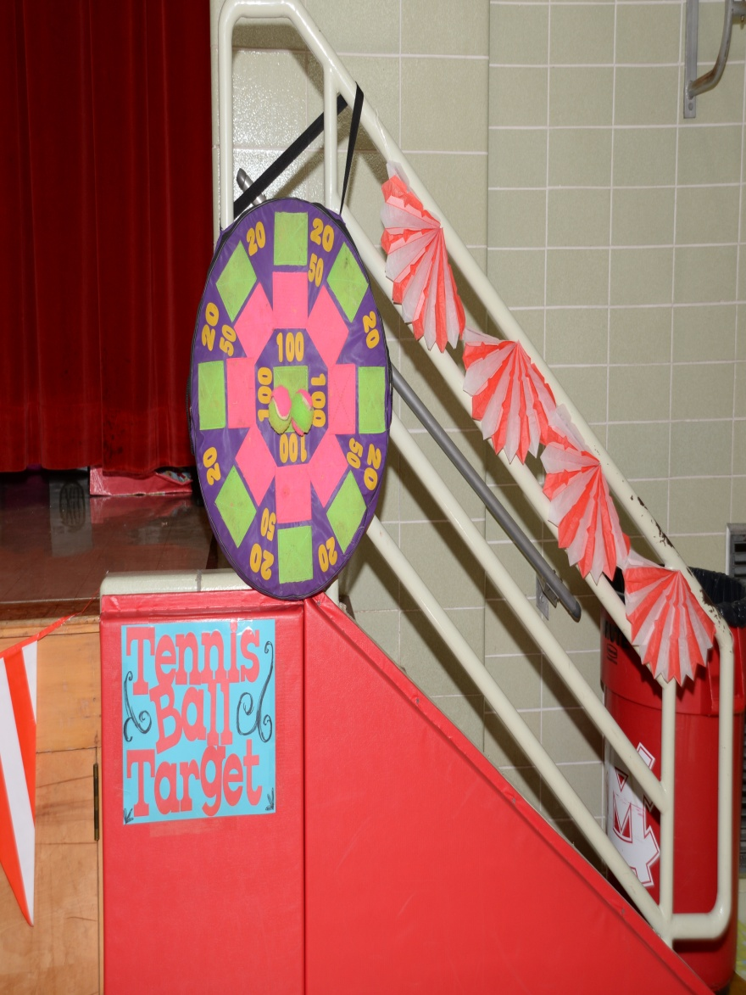
More Fun

Slide 54
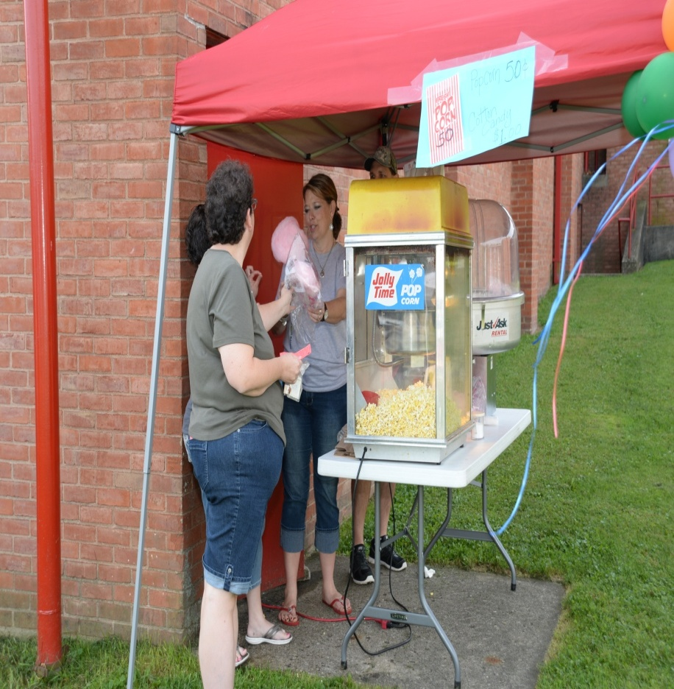
Cotton Candy & Popcorn

Slide 55
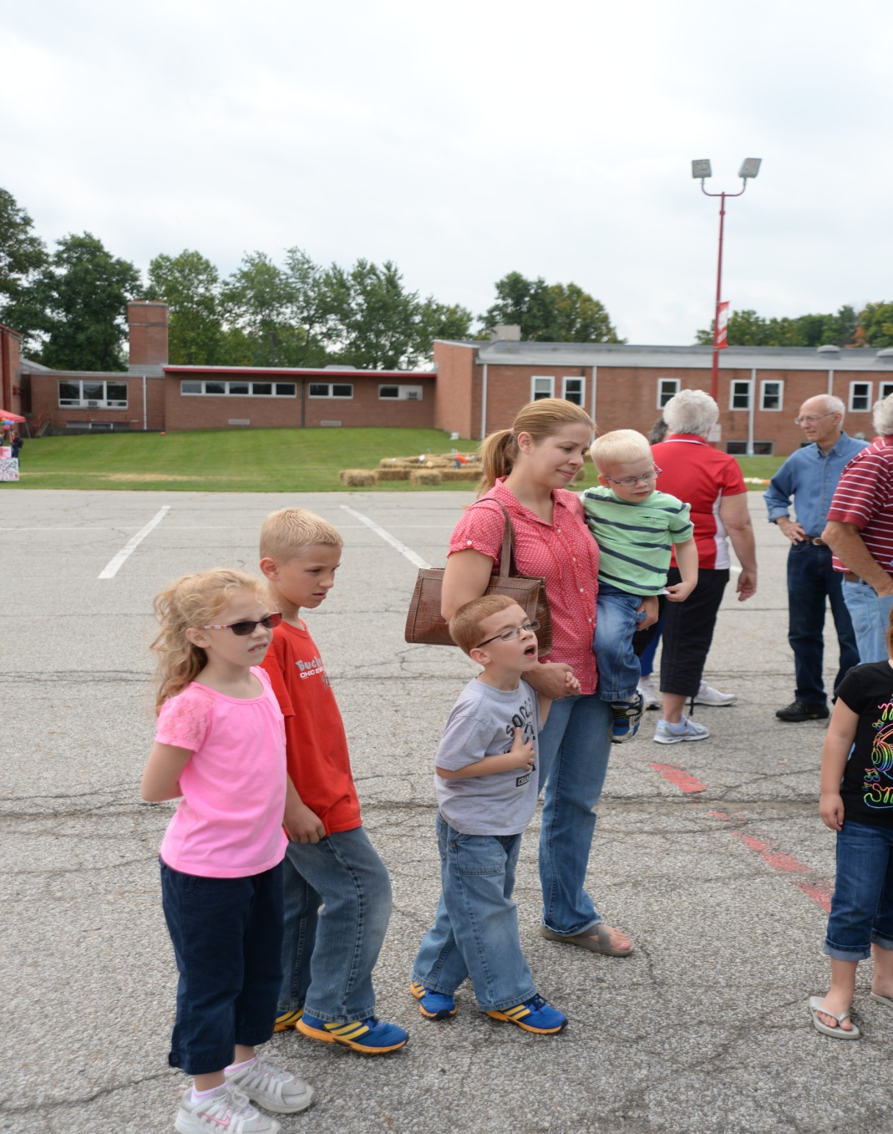
Linda & Grandkids

Slide 56
Sophmore Class selling Pumpkins and Mums?
or teachers?

Slide 57
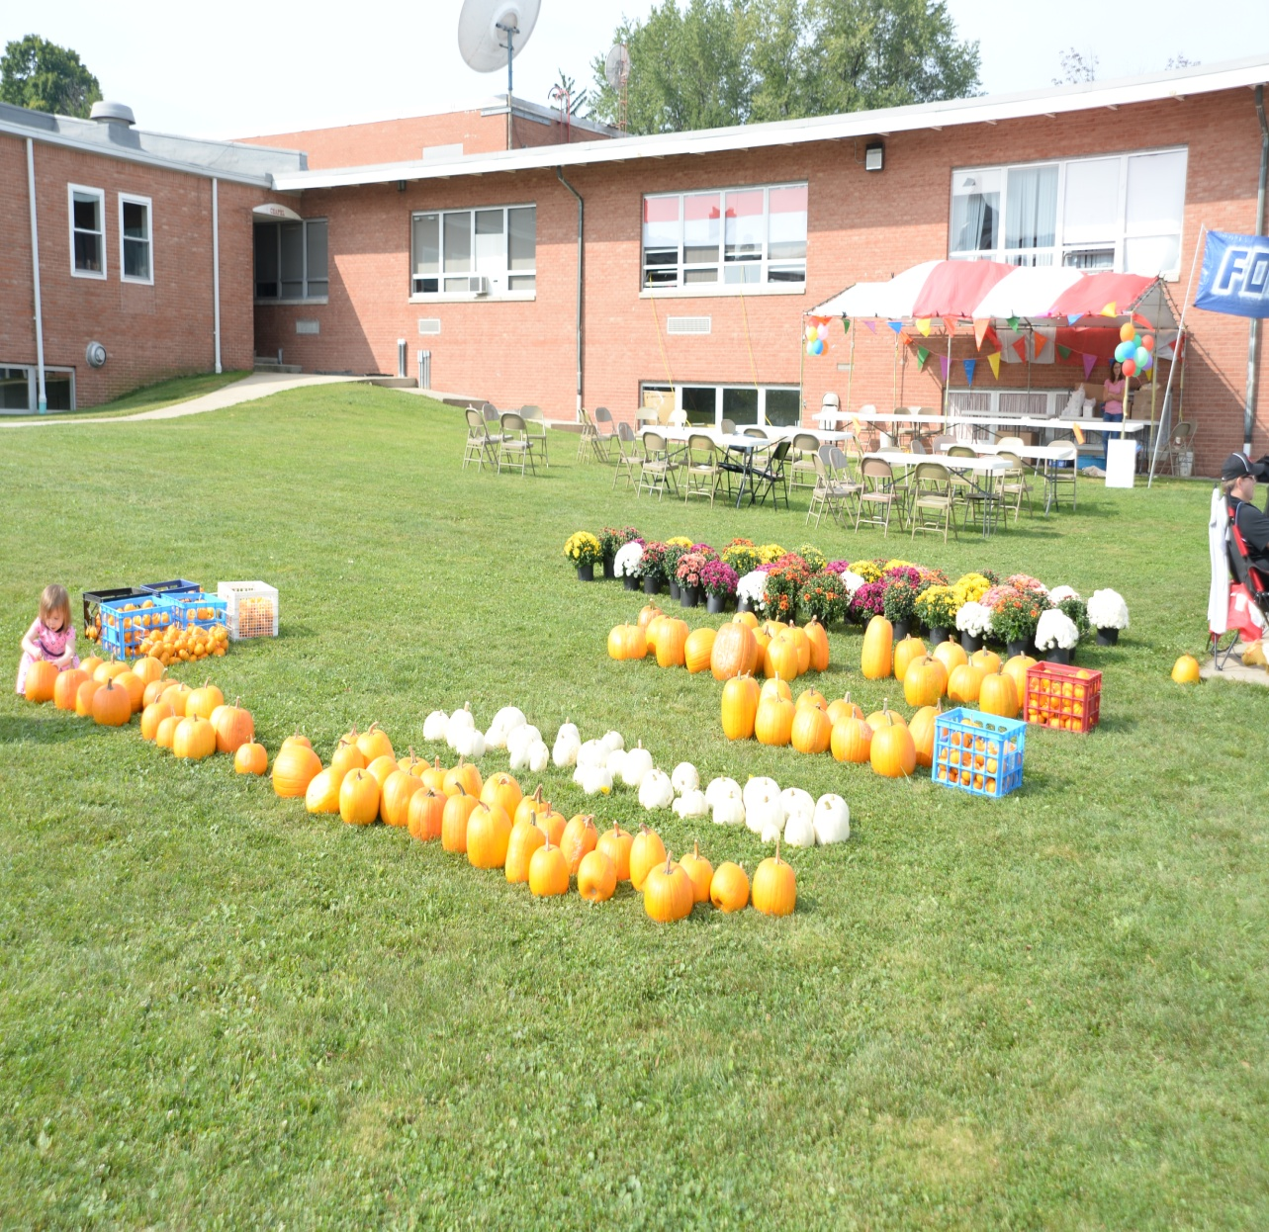
Outside Fun – Hay maze

Slide 58
Thank you Ford
200 Test Drives

Slide 59
Thank you Graham Ford of Mansfield
We received $4000

Slide 60
Total Funds Raised
$10,000
$5000 – Technology
$5000- Classroom Resources

